Slide 1

Ant Colony Optimization

Slide 2
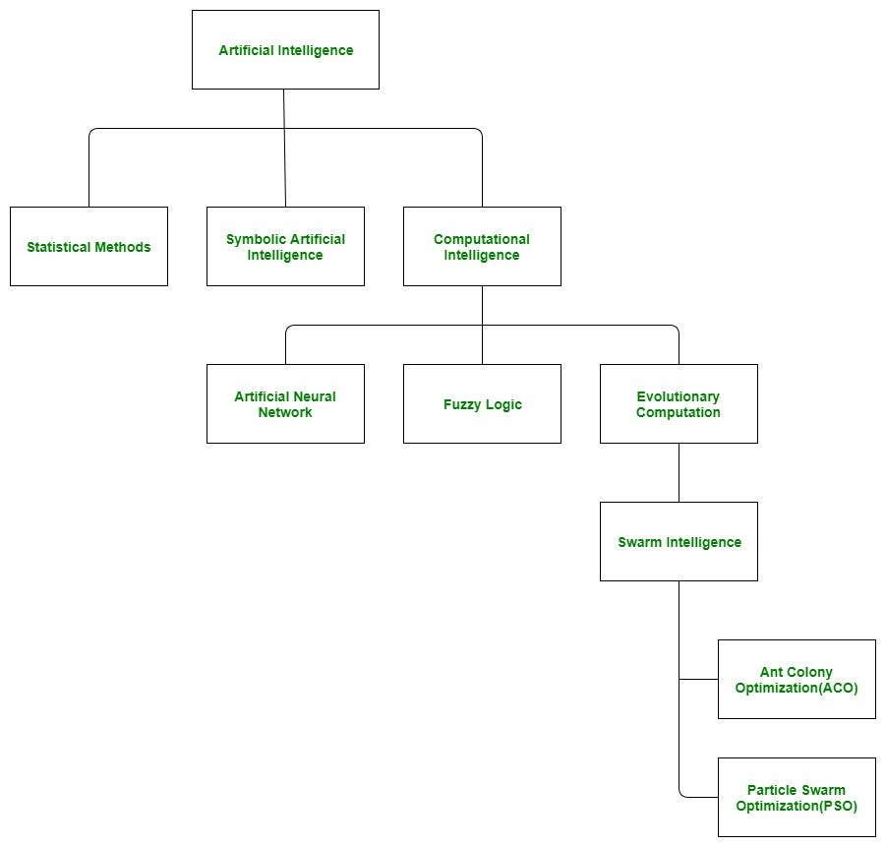
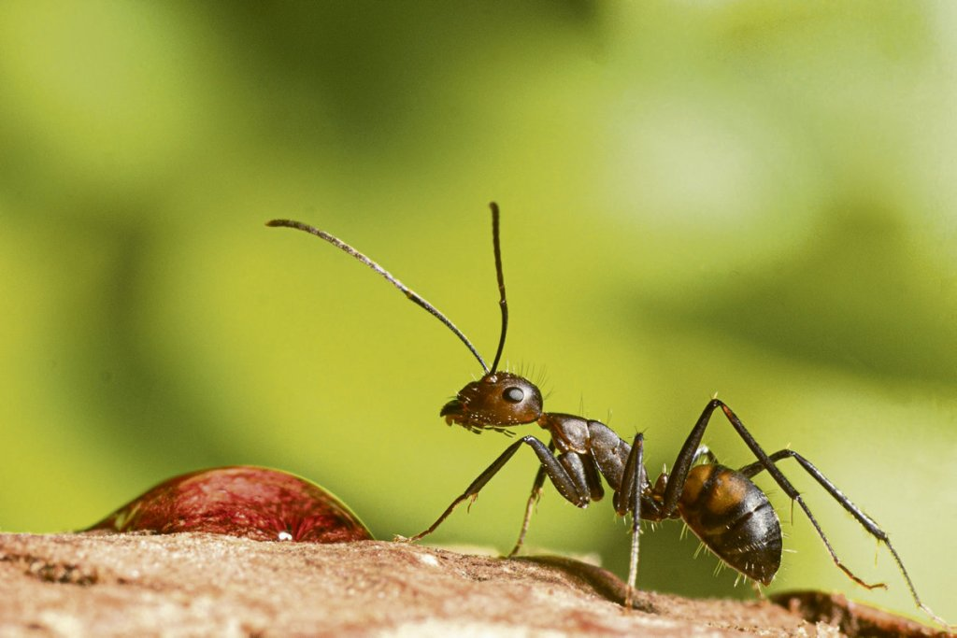

Slide 3
Title: Subdomains of Artificial Intelligence (AI)
Introduction to AI:
Artificial Intelligence is a vast field of research and application that encompasses various methodologies and techniques aimed at simulating human intelligence using machines.
Three Main Branches of AI:
Statistical Methods: Utilize probability and statistics to interpret and predict data.
Symbolic Artificial Intelligence: Relies on the manipulation of symbols and logical rules for reasoning.
Computational Intelligence: Draws inspiration from natural and biological processes to solve complex problems.
Focus on Computational Intelligence:
Artificial Neural Networks: Models inspired by the human brain for learning and making predictions.
Fuzzy Logic: Systems that use degrees of truth rather than binary logic to reason about imperfect data.
Evolutionary Computation: Algorithm that mimics natural evolutionary processes to optimize solutions.
In-depth Look at Evolutionary Computation:
Subcategory: Swarm Intelligence: Systems that simulate the collective behaviors of autonomous agents, such as birds and insects.
Ant Colony Optimization Algorithm (ACO):
Path: AI -> Computational Intelligence -> Evolutionary Computation -> Swarm Intelligence -> ACO
Principle: Inspired by the behavior of ants and their communication through pheromones to find the shortest and most efficient routes.
Application: Used to solve combinatorial optimization problems, such as the traveling salesman problem.
Conclusion:
Ant Colony Optimization (ACO) is a remarkable example of how observing nature can lead to significant advances in AI, providing elegant solutions to complex problems.

Slide 4
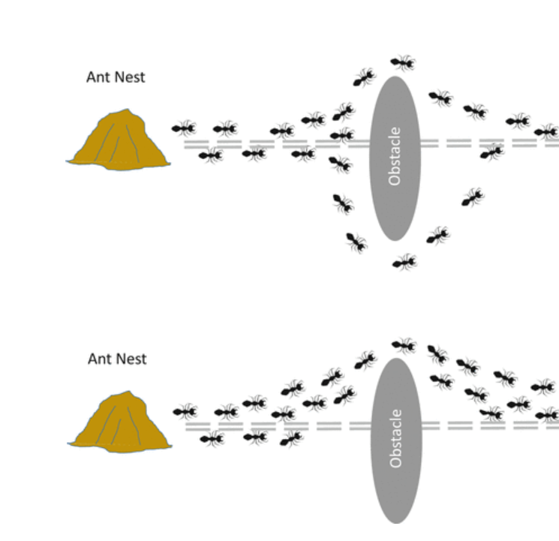
Understanding the Fundamental Steps of the Ant Colony Optimization Algorithm
1. Initialization
2. Ants' Solution Construction
3. Evaluation of Solutions
4. Update Pheromone Levels
5. Display the Best Result

Slide 5
1.Initialization:
Create a population of virtual ants and initialize pheromones on all possible solutions.
Define parameters such as iteration, number of ants (n_ants), number of cities (n_citys), evaporation rate (e), alpha, and beta.
Calculate visibility based on the reciprocal of distances, replacing infinite distances with zero.
Initialize the pheromone matrix (pheromne).
2.Ants' Solution Construction:
Each ant constructs a solution by selecting successive routes, influenced by pheromones deposited on paths.
The probability of choosing a path is a function of both pheromone levels and visibility (inverse of distance).
3.Evaluation of Solutions:
Evaluate the quality of each solution constructed by ants using a specific objective function.
Identify the ant with the minimum tour distance (best_route).
4.Update Pheromone Levels:
Update pheromone levels locally for each ant and globally for evaporation and reinforcement.
Perform evaporation on all edges to simulate the natural decline of less-used paths.
Update pheromone levels based on the chosen ant's tour.
5.Display the Best Result:
Print the final routes of all ants (rute_opt), the best route (best_route), and the cost of the best route (dist_min_cost).
These steps are iteratively repeated until the algorithm converges to an optimal or satisfactory solution.

Slide 6
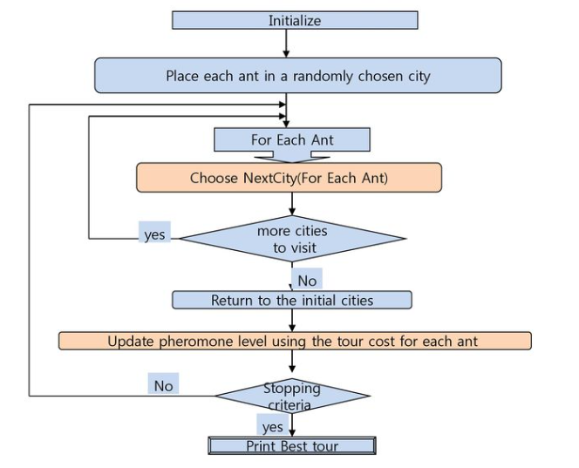
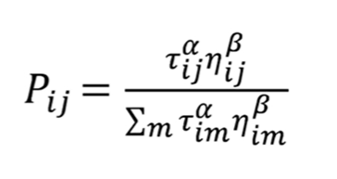
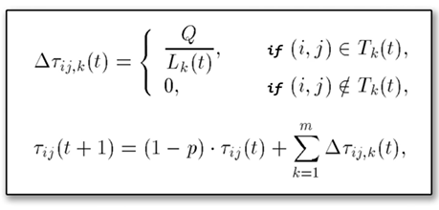

Slide 7
Title: Understanding the Ant Colony Optimization (ACO) Algorithm
Objective:
Illustrate the key steps of ACO, a bio-inspired algorithm used to find optimal paths in optimization problems.
Algorithm Steps:
1.Initialization:
Begin by placing each ant in a randomly chosen city.
2.Path Construction Loop:
For Each Ant:
Choose the next city to visit based on the calculated probability from pheromone levels and distance.
3.Loop Criterion:
If other cities remain to be visited, return to step 2.
Otherwise, return to the starting city.
4.Pheromone Update:
After constructing all paths, update pheromone levels based on the cost (distance) of the path taken by each ant.
5.Stopping Criterion:
If a stopping criterion is met (such as a defined number of iterations or a path quality threshold), continue.
Otherwise, return to step 2 for a new iteration.
6.Final Result:
Display the best path found after all iterations.
Key Concepts:
Pheromones: A virtual chemical substance that ants "deposit" on the path, influencing the choice of path for other ants.
Probability: Calculated from the amount of pheromones and distance, determining the next city an ant will visit.
Optimization: Iterative process of improving paths based on feedback from previous routes.
Conclusion:
ACO is a powerful example of swarm intelligence algorithms that simulate collective behaviors to solve optimization problems. It is widely used in areas such as logistics, network planning, and scheduling.

Slide 8
Let's break down the key hyperparameters and parameters in the Ant Colony Optimization (ACO) algorithm along with the corresponding formulas:

Slide 9
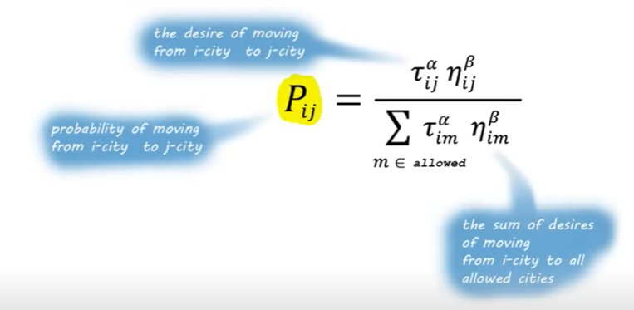
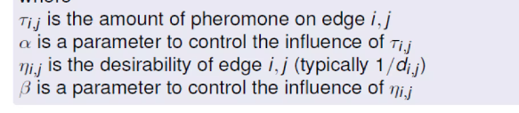
Probability of an ant moving from one city to another

Slide 10
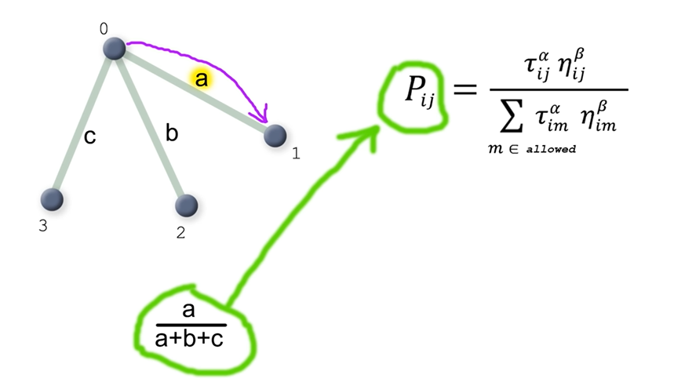
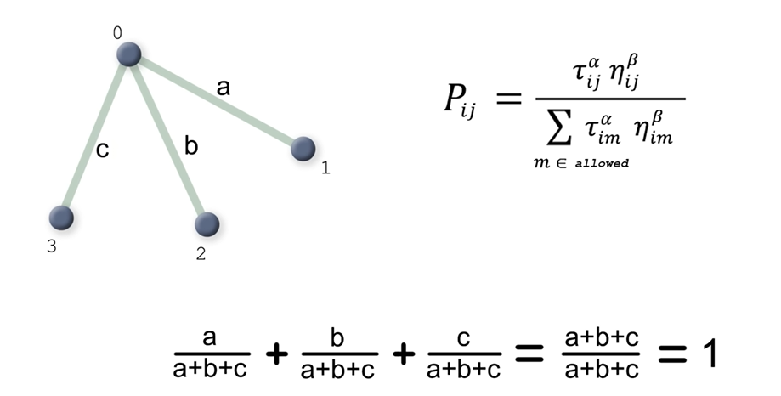
Let’s have a look at an example:

Slide 11
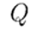
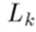
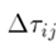
Distribution of pheromone across the path
number of Ants
pheromones Evaporation Rate
constant of Pheromones Deposit (Q)
is the total distance of the tour made by ant k
is the pheromone update for the edge between cities i and j
index of an ant
iteration number

Slide 12
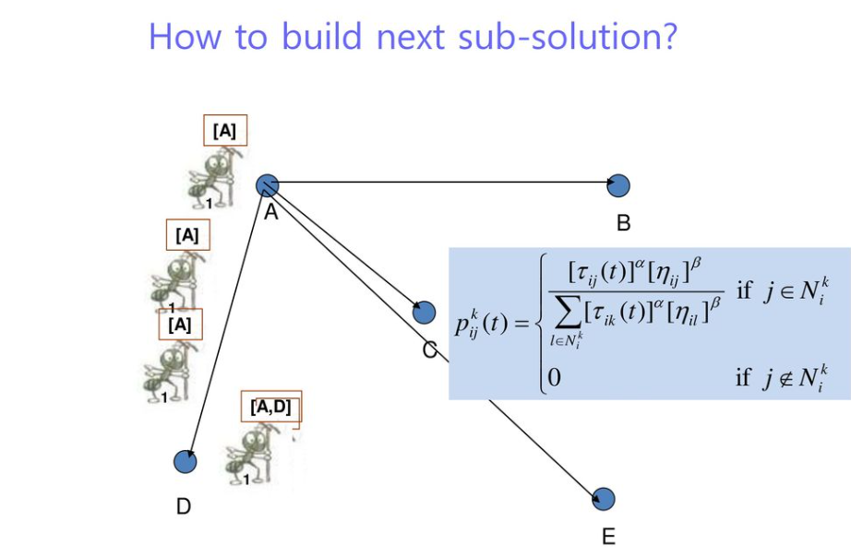
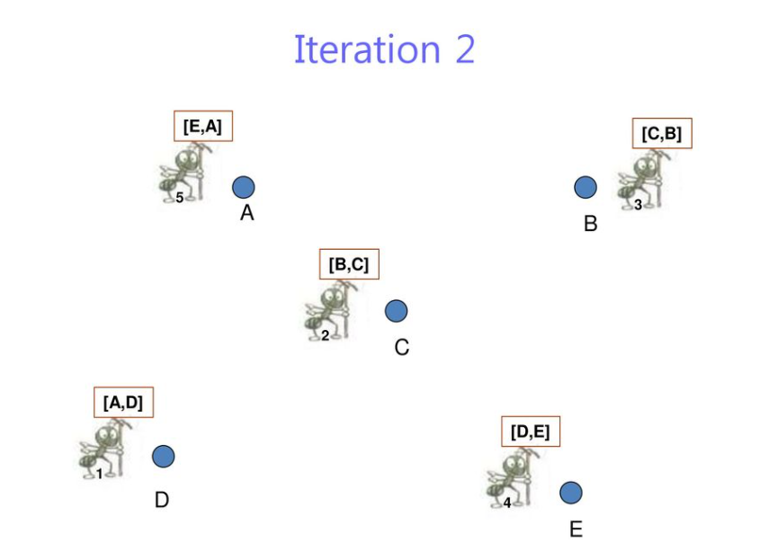
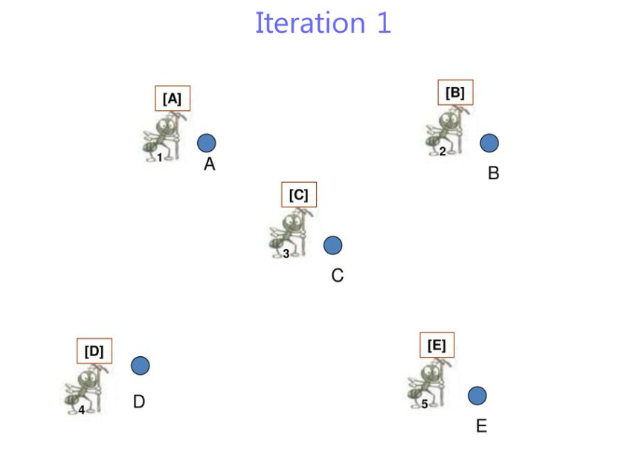
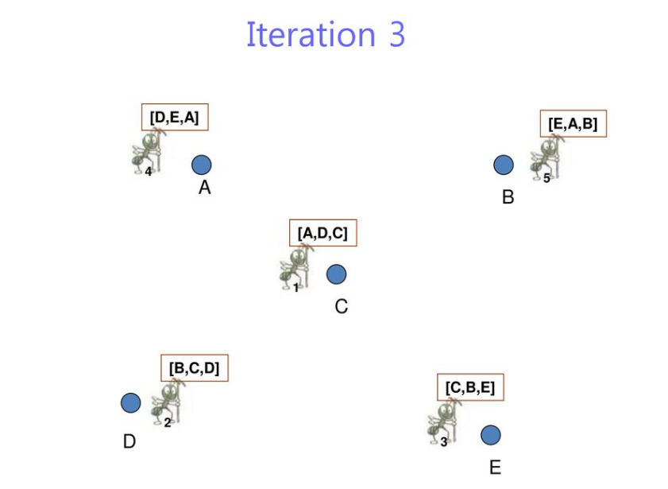
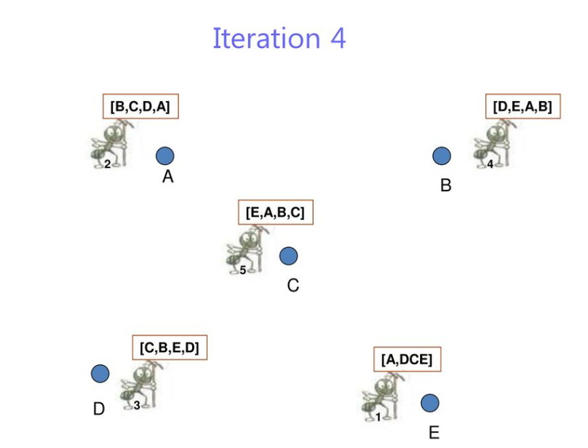
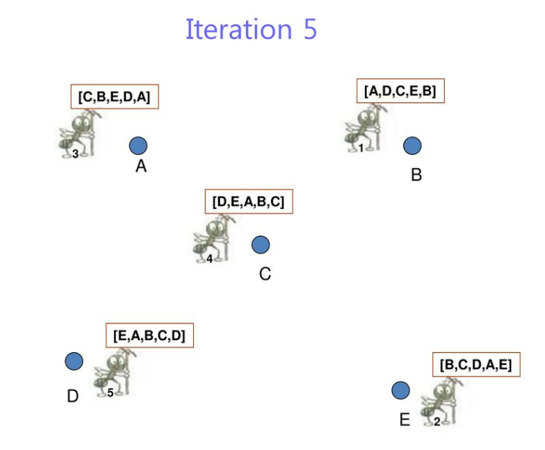
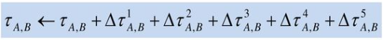
Pheromone update :

Slide 13
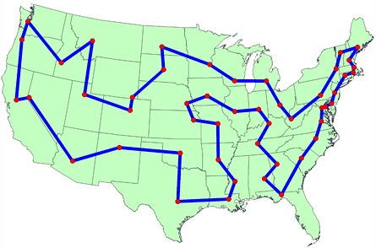
Practical Scenerio : Traveling Salesman Problem

Slide 14
Practical Scenerio : Traveling Salesman Problem
The TSP involves finding the shortest possible route that visits a set of cities and returns to the original city
Given N cities, and a distance function d between cities, find a tour that:
Goes through every city once and only once
Minimizes the total distance
-Problem is NP-hard
-Classical combinatorial optimization problem to test.

Slide 15
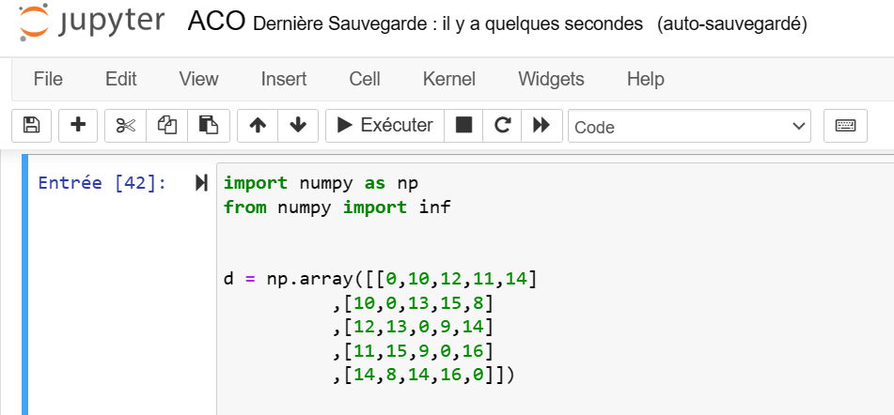
Ant Colony Optimization for the Traveling Salesman Problem
1.Given Values:
This represents the distance matrix between cities. For example, d[1, 2] represents the distance between city 1 and city 2.

Slide 16
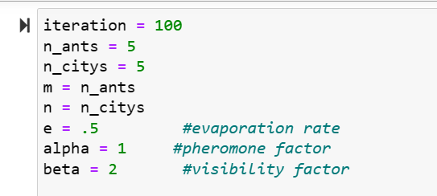
2.Initialization: iteration: Number of iterations. n_ants: Number of ants. n_citys: Number of cities. e, alpha, and beta: Parameters for evaporation rate, pheromone factor, and visibility factor, respectively.

Slide 17
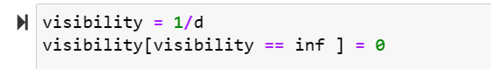
3. Visibility Calculation: We calculate the visibility of the next city: visibility(i, j) = 1 / d(i, j) handle cases where d(i, j) is infinite.

Slide 18
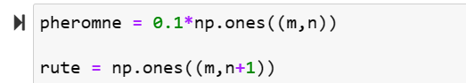
4.Initialization of Pheromones and Routes:
We set initial pheromone levels (pheromne) and initialize ant routes (rute)
pheromne: Initial pheromone levels on paths.
rute: Initial routes of ants.

Slide 19
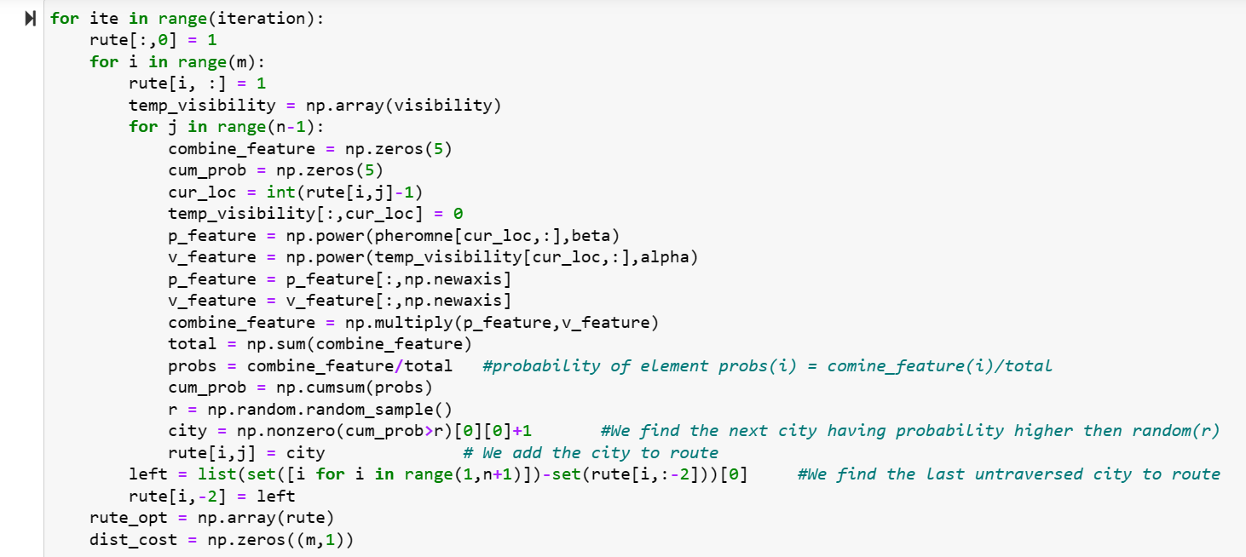
5. Ant Colony Optimization Loop:

Slide 20
**Main Loop (for ite in range(iteration)):**
**Objective:** Repeat the optimization process for a certain number of iterations.
**Action:** For each iteration, ants construct solutions following rules based on pheromones and path visibility.
**Loop for Each Ant (for i in range(m)):**
**Objective:** Each ant builds its own route.
**Action:** For each ant, it chooses the next city to visit based on pheromones deposited by other ants and the visibility of paths.
**Loop for Each Unvisited City (for j in range(n-1)):**
**Objective:** Choose the next city to visit based on pheromones and visibility.
**Action:** For each unvisited city, the ant calculates the probability of choosing that city by combining pheromone and visibility factors. Then, it makes a random choice based on these probabilities.
**Identification of the Last Unvisited City (left = ...):**
**Objective:** Identify the last unvisited city for each ant.
**Action:** Find the last unvisited city and add it to the end of the ant's route.
**Saving the Optimal Route and Initializing Distance Costs (rute_opt = np.array(rute) and dist_cost = np.zeros((m,1))):**
**Objective:** Save the best route built by all ants.
**Action:** Record the best route obtained and initialize an array to store distance costs for each ant.
In summary, this main loop iterates over the construction of solutions by ants, updating pheromones and visibility, and then saving the best solution at the end of each iteration.

Slide 21
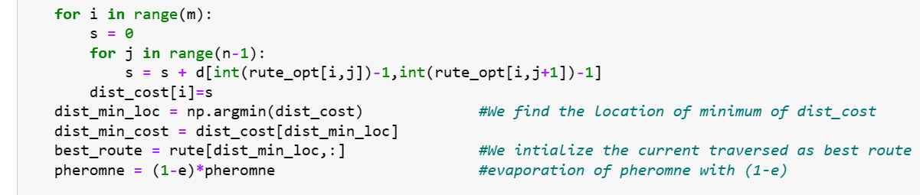
Tour Cost Calculation and Pheromone Update Loop for Each Ant Objective: Calculate the total cost of the tour for each ant. Action: For each ant: - Loop for Each City (for j in range(n-1):): - Record the Total Cost (dist_cost[i] = s). - Identify the Best Route - Identify the location of the route with the minimum cost. - Record the minimum cost. - Save the best route. Pheromone Evaporation: - Evaporate pheromone levels at a given rate (e).

Slide 22
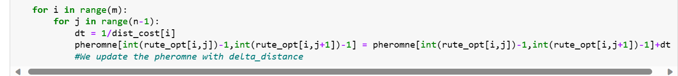
Updating Pheromones Based on the Best Route:
Loop for Each Ant
Loop for Each City
Objective: Update pheromone levels based on the best route.
Action:
For each pair of consecutive cities in the best route:
Calculate the pheromone delta based on the inverse of the total cost of the tour.
Update pheromone levels with the calculated delta.

Slide 23
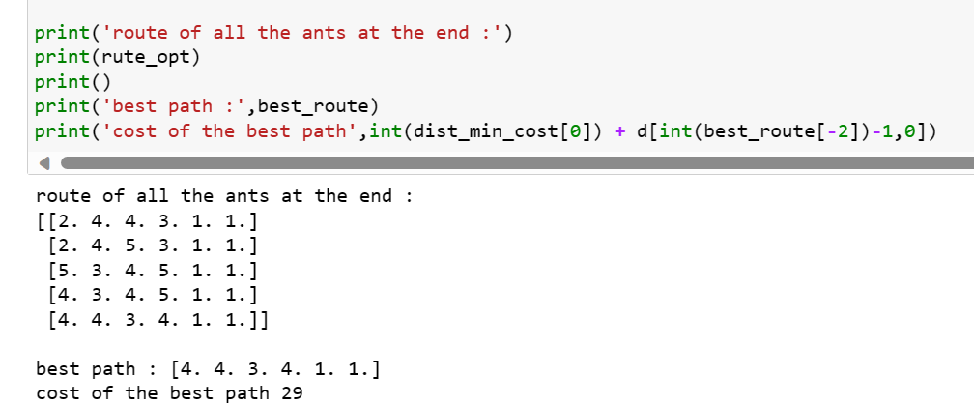
6.Results:
- We display the routes of all ants at the end (rute_opt).
- We Highlight the best path and its cost.

